Slide 1


Software Engineering TEAM 4.
Kim Woo Kyung [Team Leader, Backend]
Moon Jae Wan [Machine Learning]
Ju Hye Won [Frontend]
Seong Chang Min [Crawling]
Notes:
Hello, everyone.
This is Team 4, and I will introduce our product --- named Picket.

Slide 2



01. Overall target System
Integration
Provide ‘single’ shopping cart for shopping malls.
Convenience
Easy accessibility, adding, deleting and modifying.
Analysis
Use machine learning tool to provide black & white reviews.
Notes:
Our overall target system was,
first, we want to provide one single integration shopping cart for any shopping malls.
second, we want to give convenience internet shopping service to customers.
Because when customers do shopping, they usually do not use single shopping mall, they want to compare the products from different brands or different sites.
So, we will try to give easy accessibility to all sites, easy adding, deleting and modify the items they want to buy
Thired, we want to provide the black and white reviews to the customers.
1. Integration
여러 사이트들의 통합 쇼핑몰 카트 제공
2. Convenience
크롬 익스텐션을 이용하여 편리한 접근성을 제공. 직관적인 사용성, 아이템의 추가, 삭제, 수정의 용이
3. Analysis
머신러닝 기술을 이용하여, 긍정, 부정 리뷰 분석 가능

Slide 3
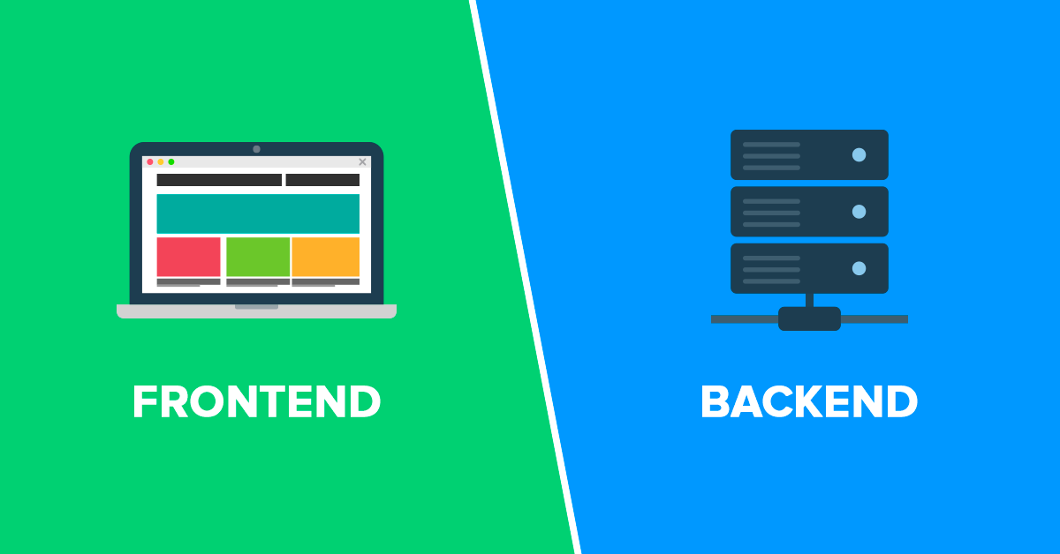

02. Overall system architecture
Frontend
React
Backend
Django
Notes:
Our Fronted System was implemented by React framework
and Backend System was implemented by Django framework

Slide 4


Frontend
Backend
Client
Picket Server
Router
Viewer
Local Storage
Authenticator
QueryHandler
Parserer
Login/
Register
Cart
Review
Request
Model
Axios
Notes:
More detailed system architecture is like this.
At the backend, the viewer accept the http requests sent by the frontend,
and decide what sub system to be called.
Sub system consists of authenticator which process login & register operation,
Queryhandler which process the customer request, and Parserer which parse the items and reviews from the shopping mall.

Slide 5
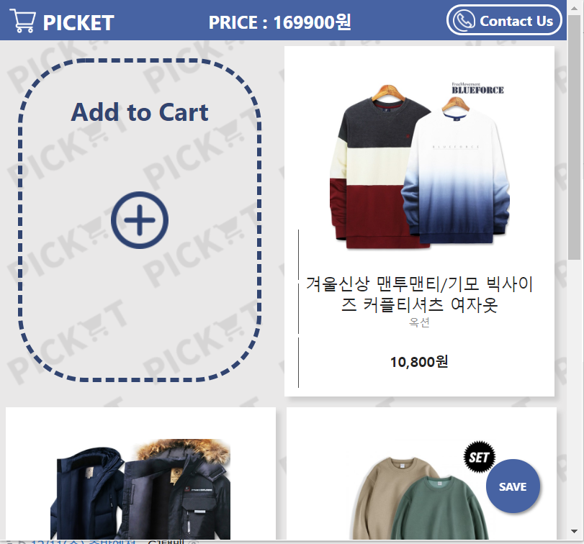
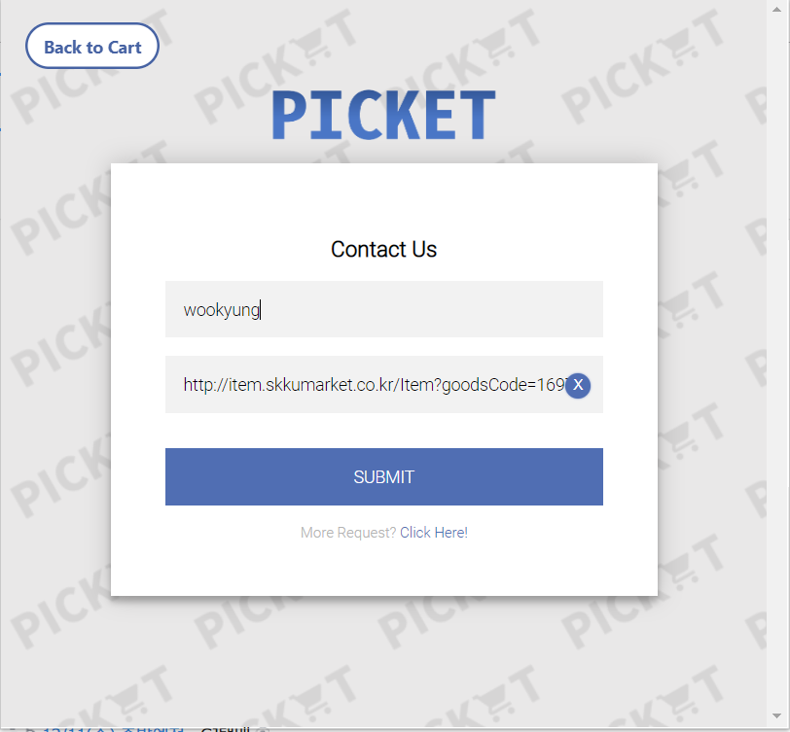
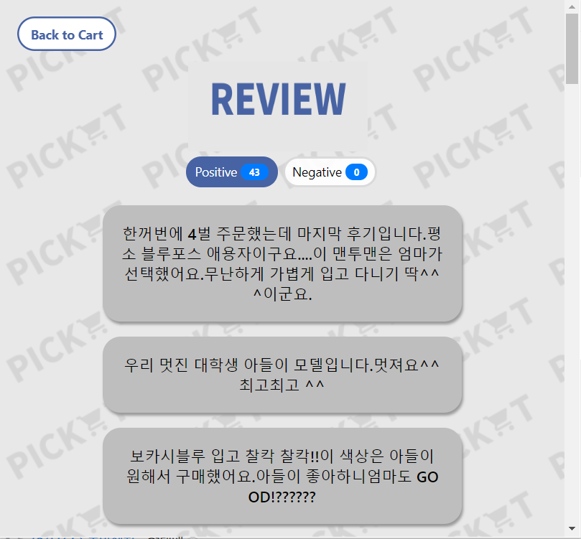
03. Main features
Shopping cart
User Request
Provide Reviews

Slide 6
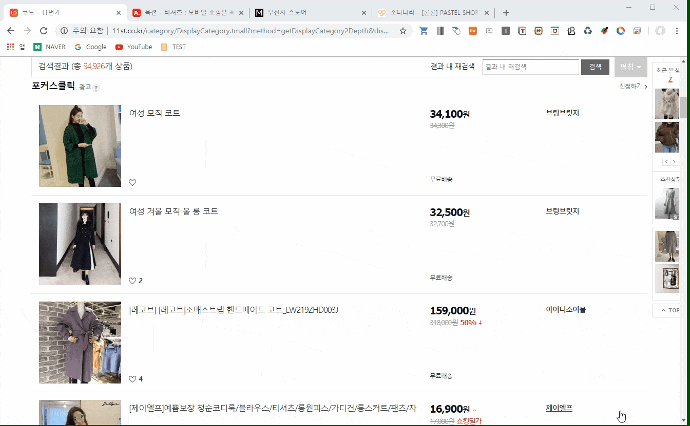
03. Main features – Demo

Slide 7
04. System completeness
A. Review parsing
B. Review Classification
Due to our lack of capacity for parsing the web pages, we cannot provide reviews for every shopping mall sites.
However, we still provide review service for some sites.
We made all the machine learning model for review classification, and testing too.
However, due to hardware unavailability server could not serve machine learning service.
Intermediate
90%
Incomplete
Complete

Slide 8
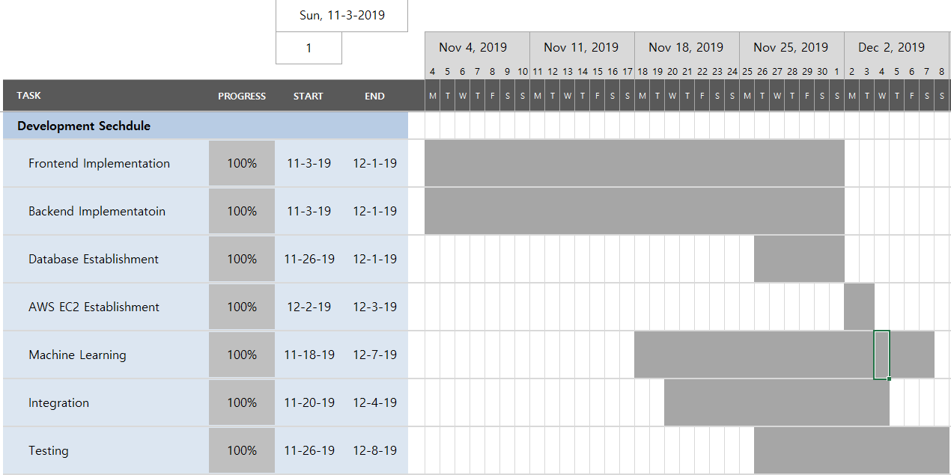
05. Actual development schedule
Start Week

Slide 9




06. Open sources
Django
React
For backend framework.
For fronted framework.
Tensorflow
C.Extension
For Machine Learning.
For client accessibility.
Libraries
BS4, Selenium, Chronium etc.
For web parsing.

Slide 10


07. Risks during project
RISK
Solution
R1. Absence of sustainable server.
S1. We used AWS EC2 server .
R2. Difficulties in review parsing,
need dynamic handling.
S2. We find out selenium lib
can handle dynamic controls.
R3. Some sites block bot to parse.
S3. We skipped does sites.
R4. Because of low-spec server
we could not serve whole
review service.

Slide 11

08. Lessons we learned
“ What I’ve learned as a backend developer, I should have all the knowledge about networking, database, server and also programming itself. I should study some fields by myself, maybe if there was few more people, implementation process could be more faster. However, for me implementing the whole service not the a page code was good experience. And also it was good opportunity to develop my own capability. ”
(우선 백엔드 개발자로써 느꼈던 점은 서버를 개발 하기 서버를 개발하기 위해서는 네트워크, 데이터베이스, 서버관리, 프로그래밍 자체 등 다양한 분야의 지식을 알아야 한다는 점이었습니다. 모르는 분야는 직접 공부하여 개발을 하기도 하여서, 만약 사람이 조금 더 있었다면 더 효율적으로 할 수 있었을 것 같습니다. 처음으로 한 페이지짜리 코딩이 아닌, 하나의 서비스를 개발하는 것 자체가 좋은 경험이었고, 개인적으로 발전할 수 있었던 계가기 되었던 것 같습니다.)
Kim Woo Kyung
Team Leader / Backend Developer
“The part of my project was the frontend of the chrome extension. The biggest mission of the project was whether users could use the service called PICKET most conveniently. So I tried to minimize the unnecessary screens and buttons to make the screen intuitively understood by users. Another difficulty was that I used react, one of the JavaScript frameworks, but it was also difficult to develop using the latest version. However, it was very rewarding to overcome these difficulties and implement and complete the features we planned. The best thing about this project was that when I was initially planning and incorporating the ideas, documenting them was the most helpful.In the early days, I wondered whether it would be worthwhile to spend time writing documents, but by writing them, I learned more about my role as well as how the whole system was organized. I was able to proceed without great difficulty.”
Ju Hye Won
Frontend Developer

Slide 12
08. Lessons we learned
“ I learned about requirements and design specifications, I actually felt a lot of difference. Is this really going to be used? But when I looked at the design specification and coded it, the things to implement were clear and it was easy to communicate with the team. It's a pity that I don't know much about the rest except parsing. ”
(요구명세서와 디자인명세서를 배울 때 사실 괴리감이 들었습니다. 이게 과연 진짜 쓰일까 하는 것 말이죠. 하지만 구현할 때 디자인 명세서를 보면서, 구현해야 할 것이 명백하고 팀원들과 소통하는데 도움이 되었습니다. 제가 맡은 부분이 파싱 부분이라 이 시스템의 다른부분에 대해 자세히 알지 못하는 것은 아쉽습니다.)
Seong Chang Min
Parser Developer
“I was in charge of machine learning in this project. There were three things I felt when I was building a machine learning subsystem. The first was that it would take a lot of effort to apply technology change to the system. In order to apply the latest ML techniques, I have read a total of 10 papers, to make the current task and the most suitable model. The second was that it took a lot of effort to create data sets that didn't exist. During coworking with the Parser team, we could find improvement direction for the parser. The third is that you cannot determine whether it works well even if you pass the unit test until you test the system environment to deploy it. While the environment used in the development process was in the compute environment where machine learning was studied, the deploying environment for the systems was lower performance than that. Because of this, machine learning took a very long time to operate, making it difficult to use it.”
Moon Jae Wan
Machine Learning Developer

Slide 13
Q & A

